Slide 1
Helping Traders Keep On Trading

Slide 2
Challenges Facing Traders
80%
of firms have seen an increase to their costs
66%
have seen an increase in overseas transport times
Brexit, the pandemic, inflation, price hikes (fuel, steel, shipping containers) and skill shortages (e.g. drivers) are all challenges businesses continue to face.
Trading businesses must now also be prepared with customs declarations and additional paperwork.
From 1st January 2022 full customs controls were introduced at GB borders.
All imports and exports will require full customs clearance and tariffs to be paid, without the option to delay these unless the goods are moving from NI to GB.
Businesses tell us it feels daunting - and it’s complicated work.

Slide 3
ChamberCustoms
Who We Are
We are compliant and efficient with speedy processing of customs declarations and transit documents
ChamberCustoms are experts in the complex nature of international import and export.
We support small to large businesses, who are importing and exporting, with specialist knowledge to overcome challenges and identify opportunities.
Our knowledgeable teams are based across the UK in your local Chambers of Commerce.

Slide 4
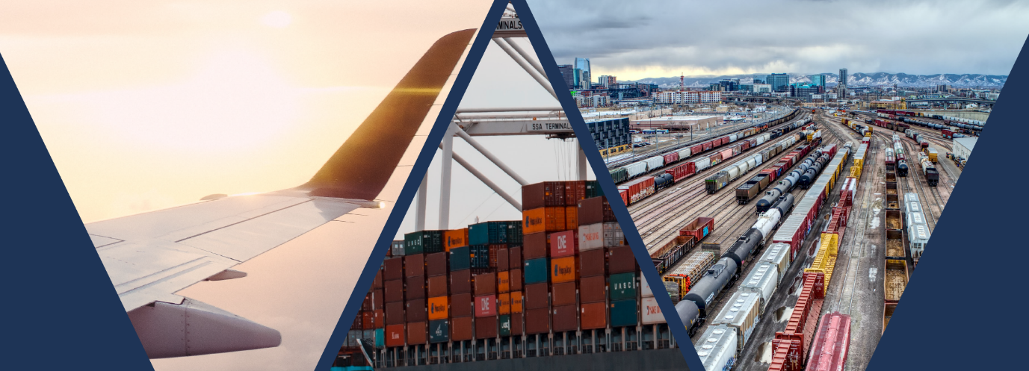
Why ChamberCustoms?
We understand the intricate nature of customs so you don’t have to.
[
[
[
We’re Connected
£ Savings
Compliance
We are the only customs broker with connections to all land, air and sea clearance ports in the UK.
Unlike other customs brokers, freight forwarders and agents – we don’t subcontract your declarations to offshore processors or to other brokers at port of entry or exit.
You deal directly with our UK based team with direct access to HMRC and all port inventory systems.
There is a minimal cost of getting it right when compared to the cost of getting it wrong’
Our in-depth knowledge and experience can save you money by:
Declaring the right commodity codes
Claiming and offering preferential tariffs
Knowing when tariffs can be applied
Taking advantage of UK International Deals and free trade arrangements
A customs declaration is a tax return, one you make on every consignment. ChamberCustoms are specialists.
We focus solely on the fiscal elements of the goods. We make sure that your declarations to HMRC are compliant with the latest border operating model.
k

Slide 5
Businesses typically turn to freight forwarders for their import and export needs
However, ChamberCustoms Brokers have:
Added experience and expertise to complete your customs declarations and transit documents
Understand the complexities of different customs unions and rules of origin
Can identify opportunities for discounts and minimising lines on your customs declarations - which can save you money.
Stay efficient and compliant with ChamberCustoms - the only customs broker with direct links to all air, sea and land port terminals in the UK.

Slide 6
ChamberCustoms are here to support you through the changes post-Brexit
How goods are cleared at the UK borders has changed and now involves more paperwork and know-how than ever before
Notes:
Replace with video

Slide 7
ChamberCustoms offers two Customs Brokerage options
Fast Track Customs Clearance
Fully-Assisted Customs Clearance
We’ll guide you through
We’ll do it all for you!
We will help you with port clearance of your Customs Declarations and Transit documents.
We will give you direct access to our system through our Exabler portal.
All you need to do is upload a spreadsheet of commodity codes and associated data for fast entry and clearance.
Once you’ve provided us with your commercial invoice, packing list, and any other supporting documents, we will file your customs declarations directly into HMRC.
We’ll confirm back once your goods have been cleared at the port.
k

Slide 8
Other ways we can support your trading business
c

Slide 9
Bespoke customs advice
For import and export customs clearance
‘Using Glasgow Chamber-Chamber Customs Service has been essential for our business post Brexit. We have been using the Chamber to complete both import and export declarations and the knowledge and responsiveness of the Chamber Team has been invaluable as we navigate the post Brexit world.
I would have no hesitation in recommending the service to other businesses”.
Iain Martin –
The Natural Fruit and Beverage Company
At ChamberCustoms we offer a bespoke customs advice consultation service from industry experts with decades of experience.
Advice & Insights
HMRC Compliance
Discounts & Efficiencies
Advice and insights from experts are specific to your business and your challenges.
We will ensure you are compliant with HMRC and overseas tax authorities.
We take advantage of any discounts and efficiencies available to you.
Two days of Customs Advisory Consultation service is typically split into:
2 hour enquiry
10 hours of research, analysis and report writing
2 hours of presentation and Q&A
c

Slide 10
Training your team
Customs Training Courses
Our training courses are delivered online and range from 1-day short courses to 13-week classroom and self-directed learning programmes.
ChamberCustoms courses are suitable for employees who are new to international trade, importing and exporting in business.
We also welcome delegates from experienced trading companies who simply need to refresh their knowledge.
Glasgow Chamber Training
What Our Clients Say:
“Thank you for constructing this course, great supporting materials and to all teachers involved for your assistance, patience and help.”
“It was a very informative course for those who want to get knowledge and understanding on customs clearance, import and export procedures. As well as, practice on how to fill import and export declarations in different situations.”
“The course was very informative and professional. Instructors are extremely helpful and patient. I'm happy to recommend it for whoever seeks training in this field.”
Two days of Customs Advisory Consultation service is typically split up into
chambercustoms.co.uk
Notes:
Missing the company name in the testimonial - I’ve asked Heidi for this

Slide 11
Meet the ChamberCustoms Directors
Liam Smyth
Managing Director
Emmanuel Gianquitto
Head of Operations and Customs Expert Consultant
Faye Busby
Director of Sales at ChamberCustoms
Liam has led the development of ChamberCustoms since 2018 working with the Chamber of Commerce network to create a team of over 150 agents delivering for traders across the UK.
Emmanuel leads the operations for Customs Brokerage and consultancy to support the international trade industry post-Brexit.
Faye is expanding the ChamberCustoms client base by harnessing the reach and expertise of the Chambers of Commerce network.
Notes:
Tidy up

Slide 12
Meet the Glasgow Chamber ChamberCustoms Team
Providing over 30 years’ experience in the Freight Forwarding and Shipping industry, Ann Marie leads the Glasgow ChamberCustoms and Certification team.
With 9 years as a Freight
Forwarder and 3 years in the Chamber International Trade team, Ettore brings essential knowledge to the ChamberCustoms team.
With a background of over 9 years in International Certification in 3 Chambers, Carol is also fully qualified to carry out customs procedures.
Ann Marie Quail
Senior International Customs & Certification Manager
Ettore (Hector) Viscontini
Customs Declarations Executive
Carol Griffiths
Customs Declarations Executive
Notes:
Tidy up

Slide 13
The team supporting your imports and exports
ChamberCustoms provides an efficient and compliant service with a friendly team who work smart and fast with your best interests in mind.
Thousands of happy customers served by our offices across the UK
We have local representatives based at Chambers of Commerce across the UK - fully integrated in the local business community.
Notes:
Find image of team or person to add to this slide

Slide 14
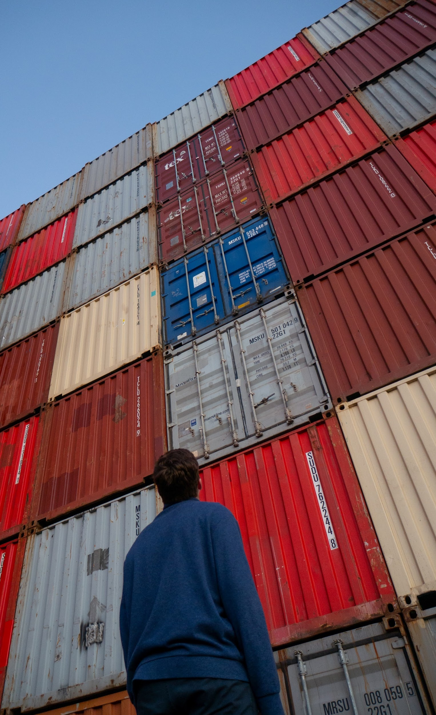
Additional Support for Trading Businesses
There are other ways that the Glasgow Chamber of Commerce can support beyond ChamberCustoms services.
Certificates of Origin
Arab Certificates of Origin
EUR1’s
ATA Carnets
Transit Documents & Guarantees
FCO Apostille
Letter of Credit
Other Documents
For further information please contact
Export Documentation | Glasgow Chamber of Commerce

Slide 15
Let’s work together to drive your business
Call us on 0141 204 2121
Visit https://www.glasgowchamberofcommerce.com/international/chambercustoms/
Helping Traders Keep On Trading
@ChamberCustoms

